Slide 1
Information System Security CMIS 422 War on Networks Module 7 Mona Taghavi

Slide 2
Session Overview
Networking basics
Network threats and vulnerabilities
Networks are threatened by attacks aimed at interception, modification, fabrication, and interruption
Wireless network
WiFi security
WPA has many critical security advantages over WEP

Slide 3
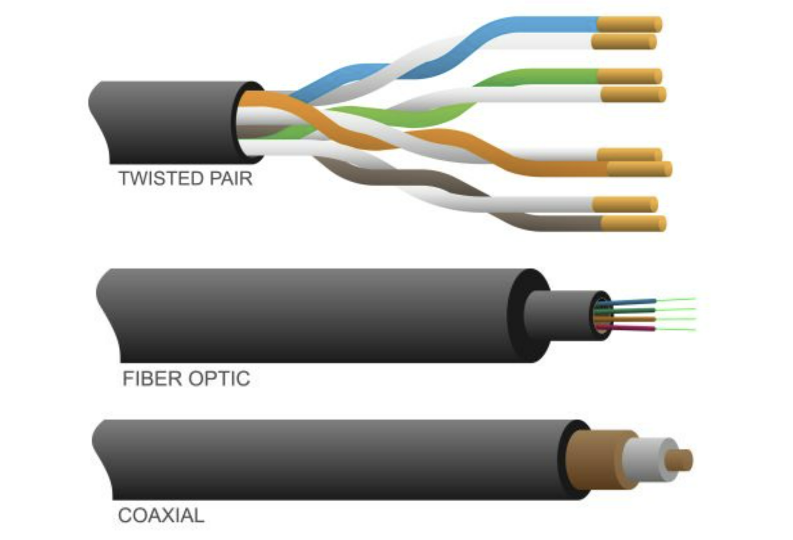
Wireline communication channel

Slide 4
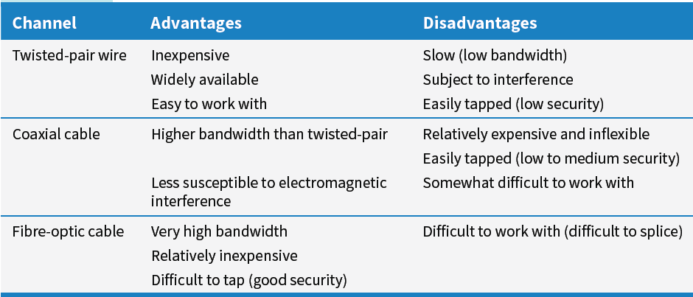
Wireline communication channel

Slide 5
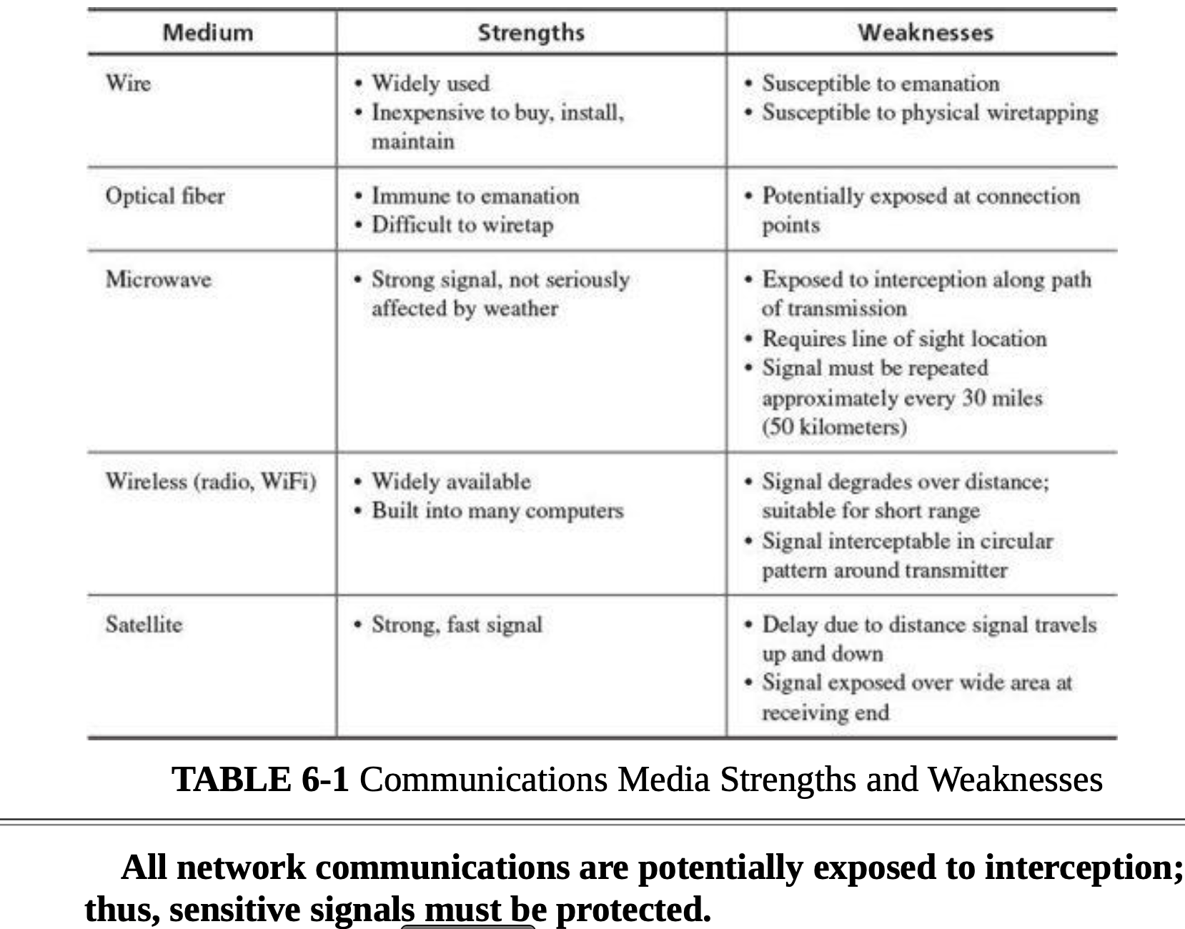
Communication Media Vulnerability

Slide 6
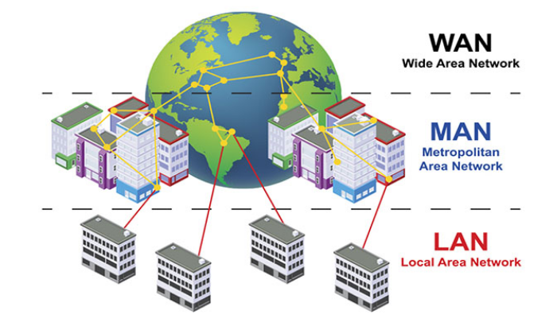

Slide 7
Communication Media Vulnerability

Slide 8
Background
What is protocol?

Slide 9
Background
What is a MAC address?

Slide 10
TCP/IP Protocol
TCP/IP PROTOCOL
The Transmission Control Protocol/Internet Protocol (TCP/IP) is the protocol of the Internet.
TCP/IP uses a suite of protocols, the primary ones being the Transmission Control Protocol (TCP) and the Internet Protocol (IP).
The TCP performs three basic functions:
It manages the movement of data packets between computers by establishing a connection between the computers,
it sequences the transfer of packets
it acknowledges the packets that have been transmitted.
The Internet Protocol (IP) is responsible for disassembling, delivering, and reassembling the data during transmission.

Slide 11
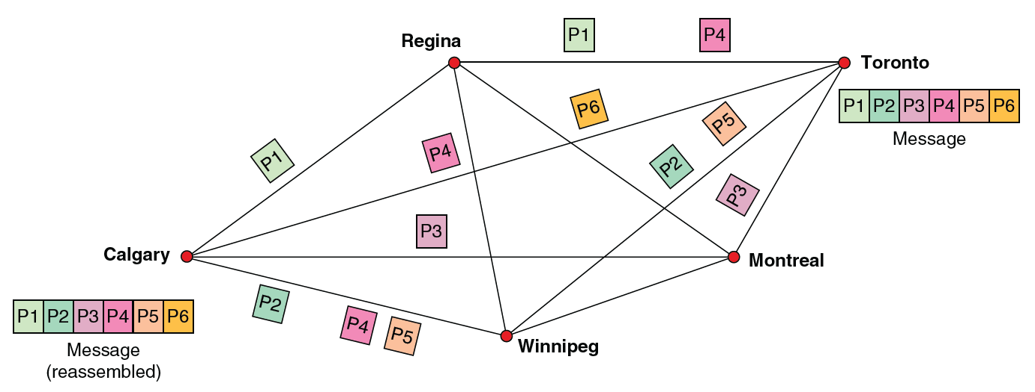
Before data are transmitted over the Internet, they are divided into small, fixed bundles called packets.
The transmission technology that breaks up blocks of text into packets is called packet switching. Each packet carries the information that will help it reach its destination—the sender’s IP address, the intended recipient’s IP address, the number of packets in the message, and the sequence number of the particular packet within the message. When the packets reach their destination, they are reassembled into the original message.

Slide 12
Layered Architecture
In a layered model
Each layer performs a subset of the required communication functions
Each layer relies on the next lower layer to perform more primitive functions
Each layer provides services to the next higher layer
Changes in one layer should not require changes in other layers
The processes on each machine at a given layer are called peer-to-peer process

Slide 13
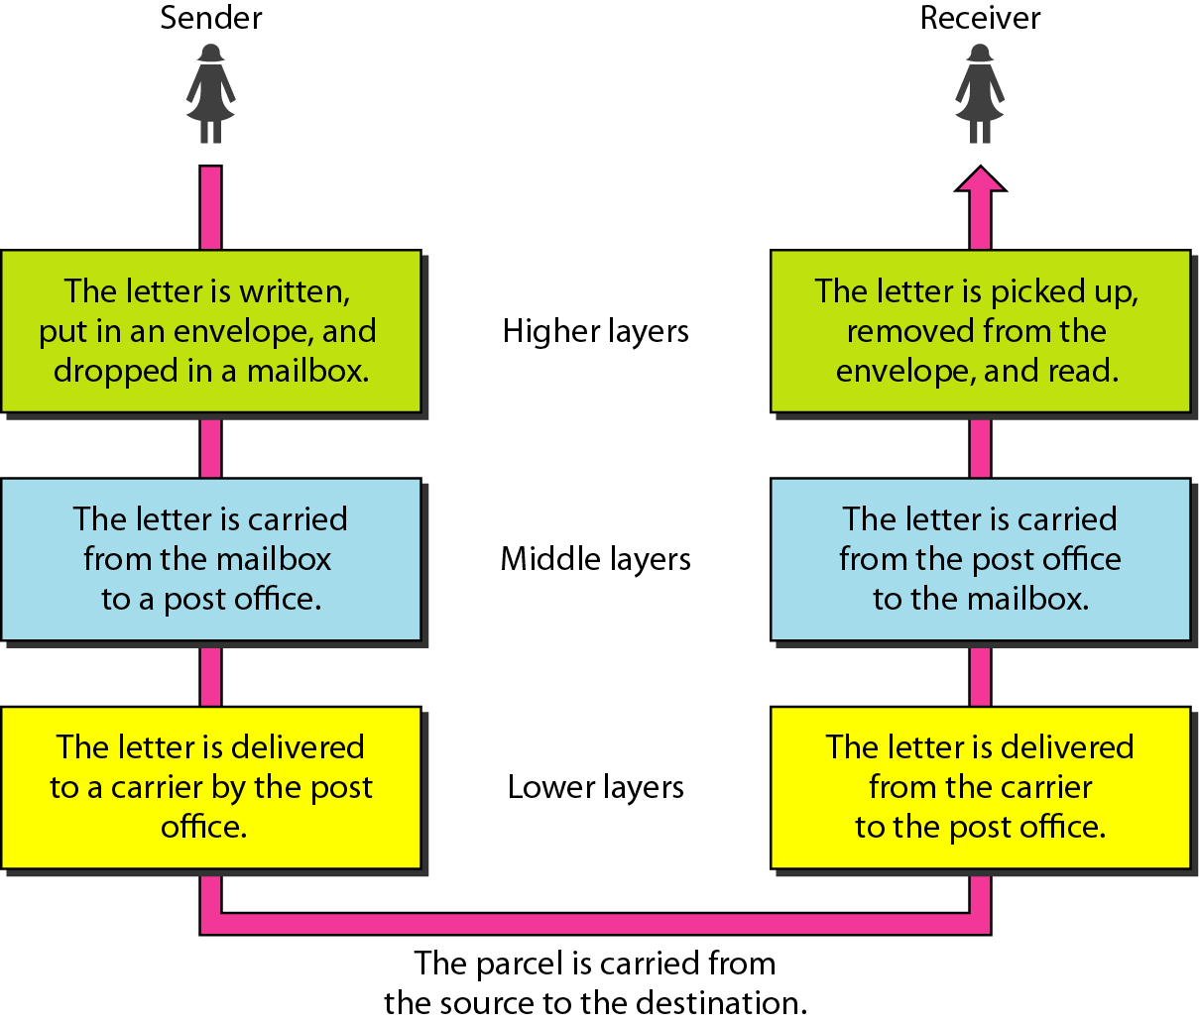
Layered tasks in sending a letter

Slide 14
Background
What is OSI?

Slide 15
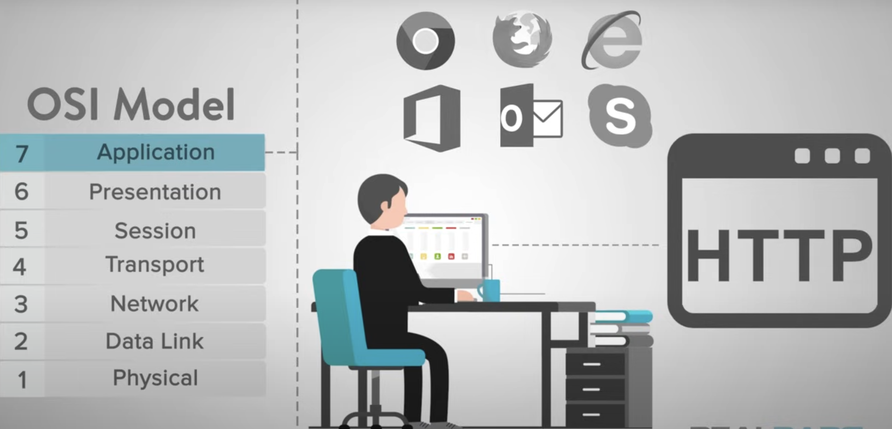
OSI Layers

Slide 16
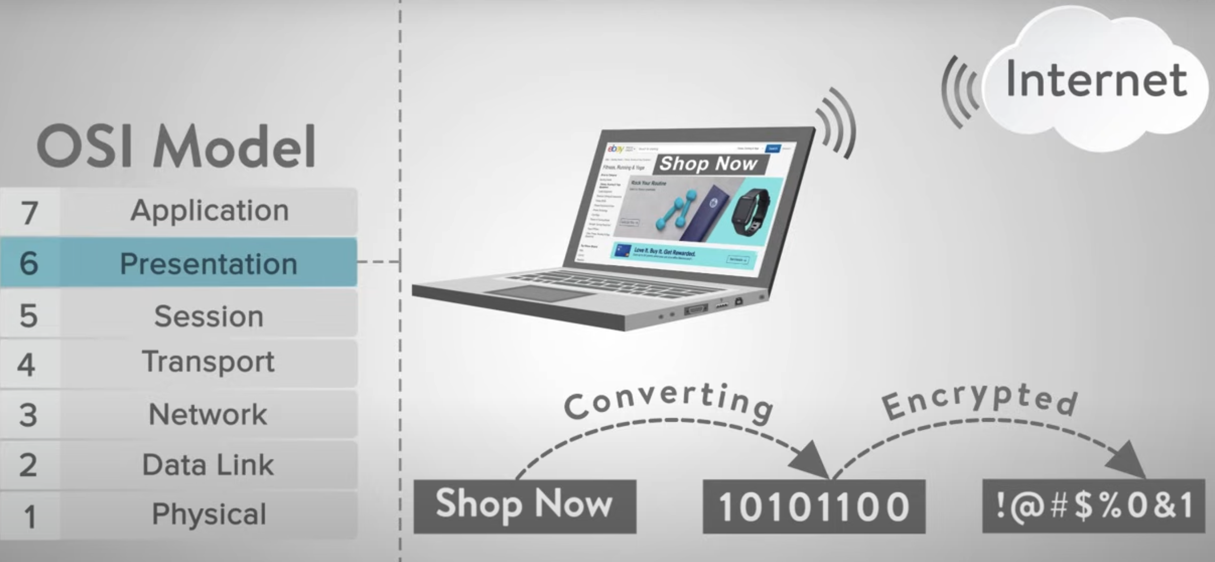
OSI Layers

Slide 17
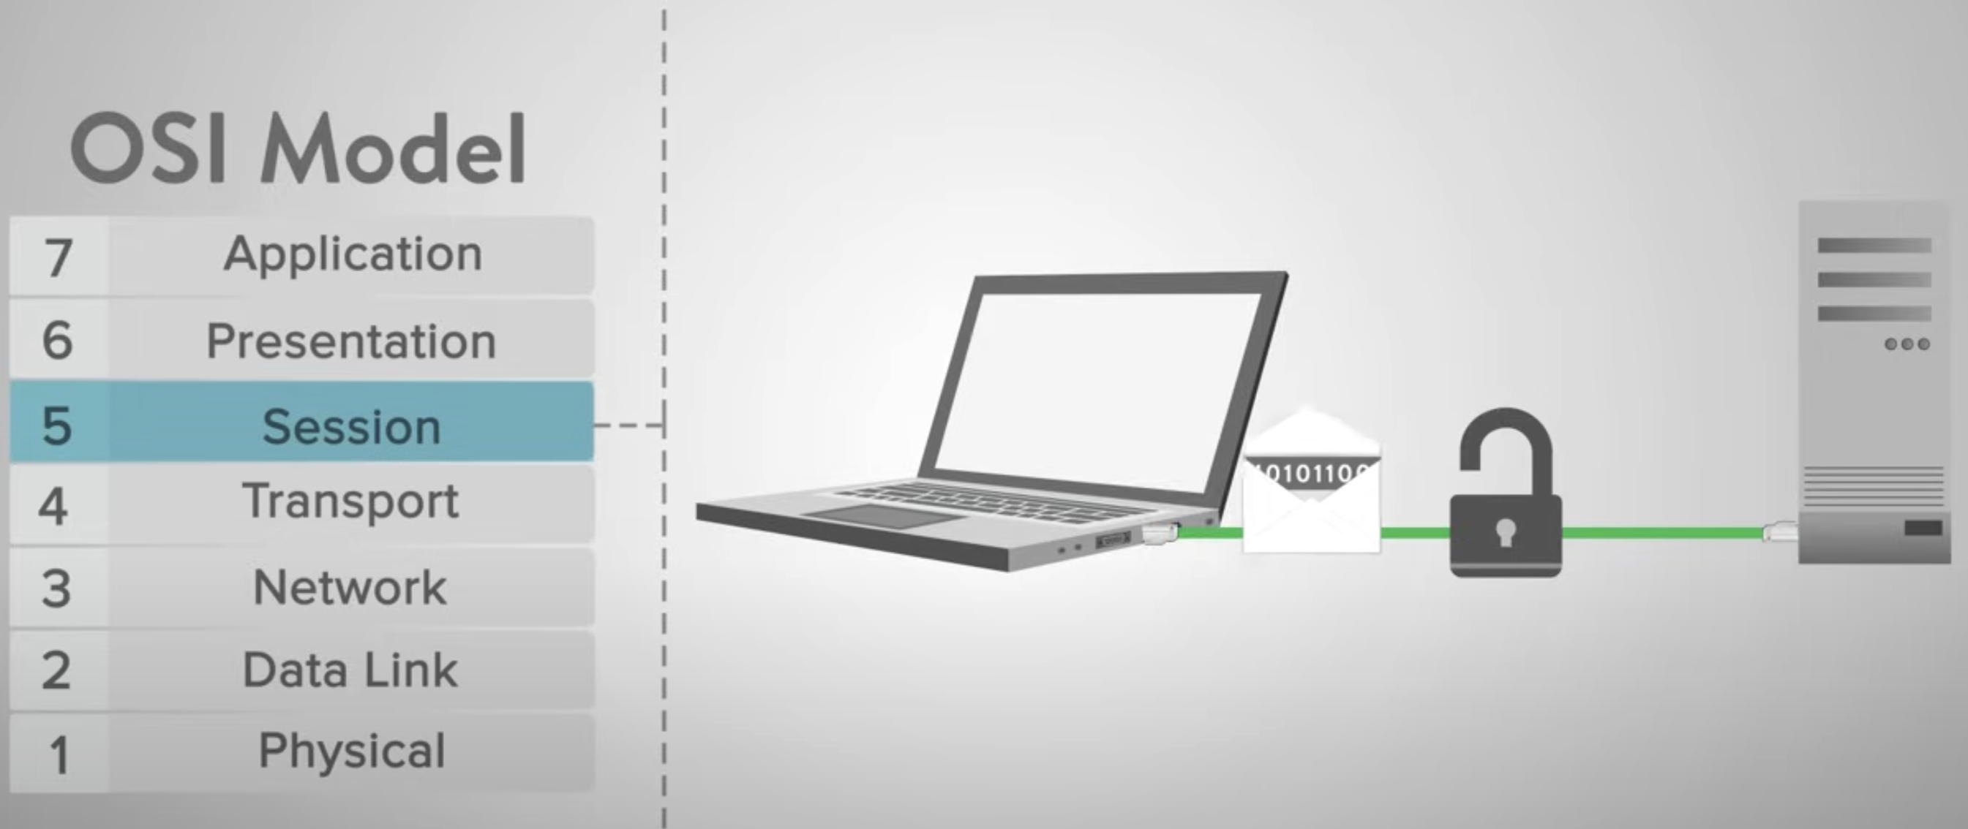
OSI Layers

Slide 18
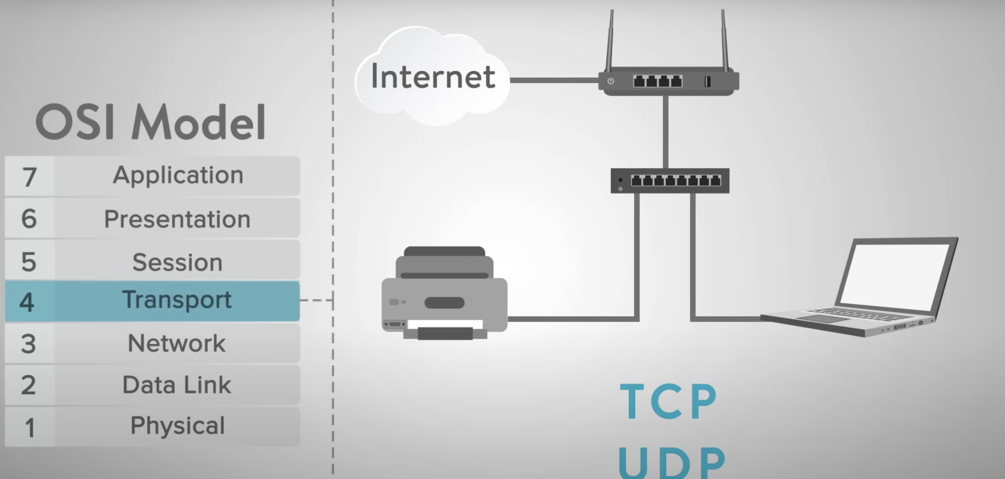
OSI Layers

Slide 19
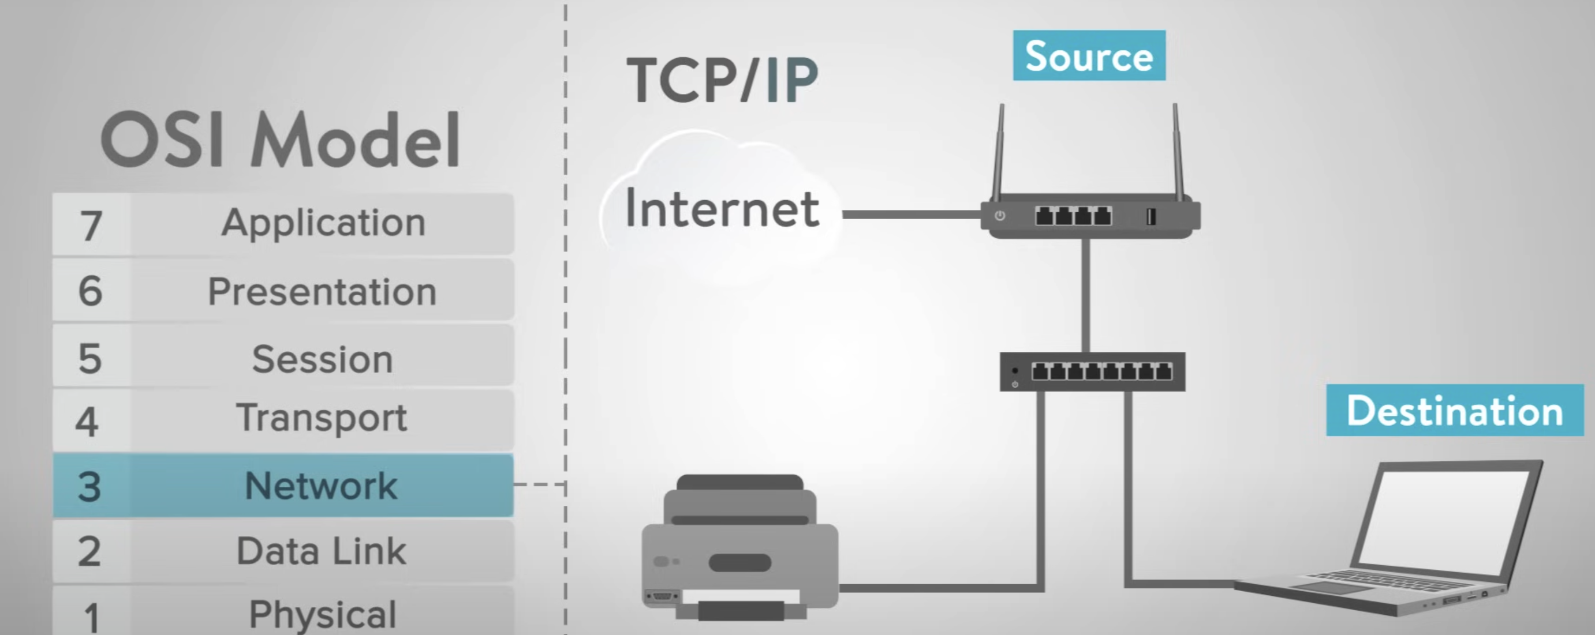
OSI Layers

Slide 20
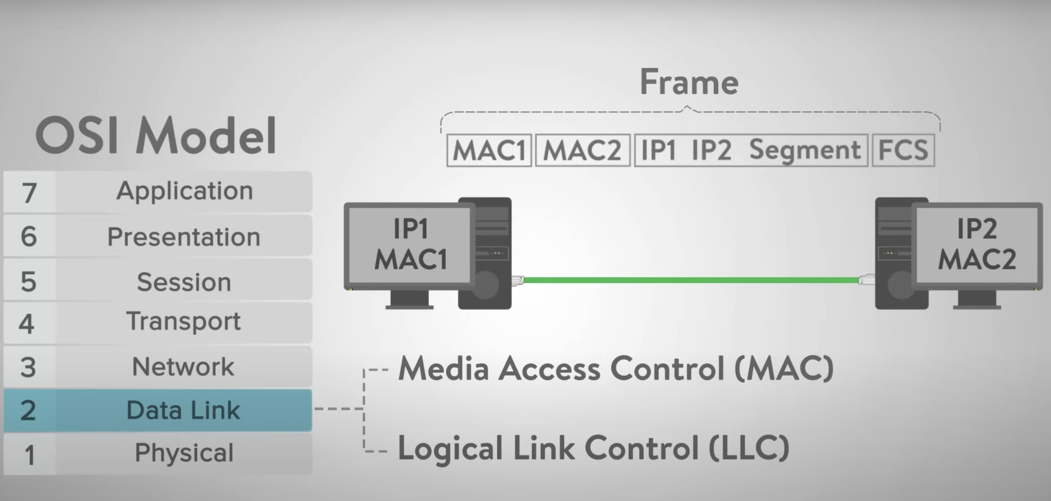
OSI Layers

Slide 21
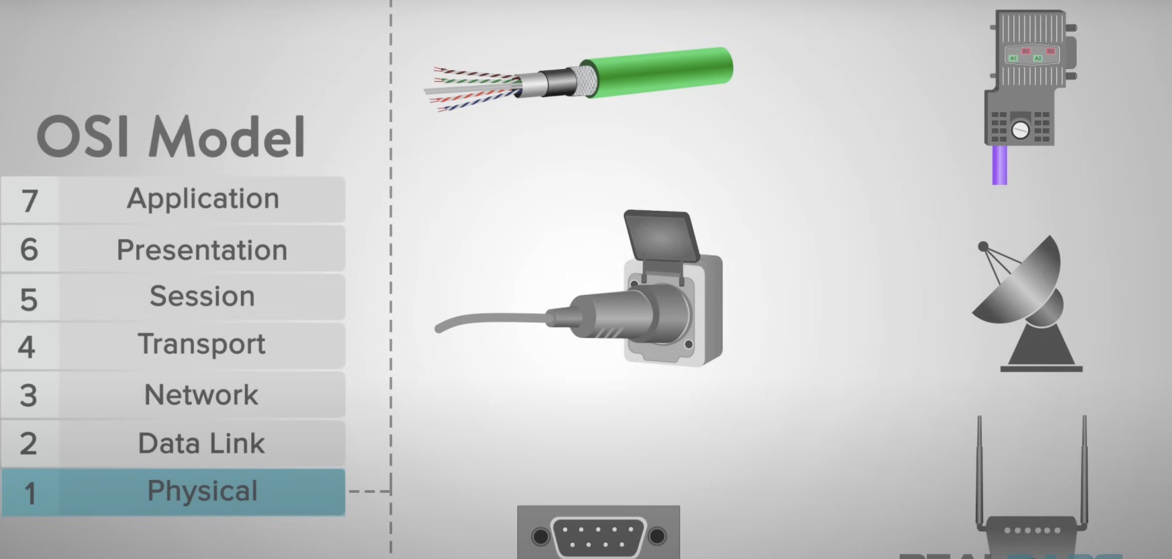
OSI Layers

Slide 22
Threats to Network Communications
Interception, or unauthorized viewing
Modification, or unauthorized change
Fabrication, or unauthorized creation
Interruption, or preventing authorized access

Slide 23
Security Perimeters

Slide 24
What Makes a Network Vulnerable to Interception?
Anonymity
Many points of attack
Sharing
System complexity
Unknown Perimeter
Unknown Path

Slide 25
Unknown Perimeter

Slide 26
Unknown Path

Slide 27
Modification and Fabrication
Data corruption
Sequencing
Substitution
Insertion
Replay

Slide 28
Modification and Fabrication
Data corruption
Sequencing
Substitution
Insertion
Replay

Slide 29
Sources of Data Corruption

Slide 30
Modification and Fabrication
Data corruption
Sequencing
Permuting the order of data, such as packets arriving in sequence
Substitution
Insertion
Replay

Slide 31
Modification and Fabrication
Data corruption
Sequencing
Substitution
Replacement of one piece of a data stream with another
Insertion
Replay

Slide 32
Modification and Fabrication
Data corruption
Sequencing
Substitution
Insertion
A form of substitution in which data values are inserted into a stream
Replay

Slide 33
Modification and Fabrication
Data corruption
Sequencing
Substitution
Insertion
Replay

Slide 34
Simple Replay Attack

Slide 35
Interruption: Loss of Service
“Interruption” is the last of our four network threat types from earlier.
We have to consider not only whether service is or is not present, but also whether the amount present is adequate.
The following are the causes of interruption:
Routing
Excessive demand
Component failure

Slide 36
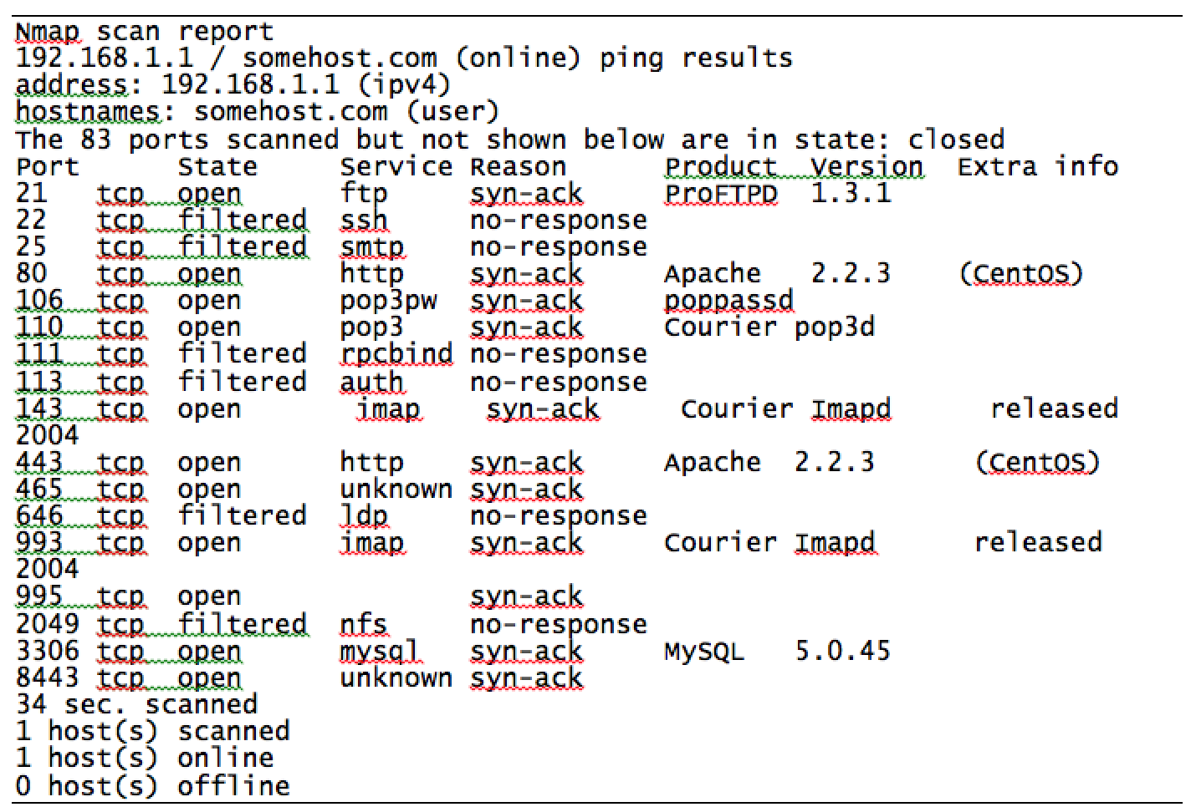
Port Scanning

Slide 37
Wireless Communication
A wireless network consists of an access point or router that receives, forwards and transmits data, and one or more devices, sometimes called stations, such as computers or printers, that communicate with the access point. The access point is the hub of the wireless subnetwork.
Each device must have a network interface card, or NIC, that communicates radio signals with the access point. The NIC is identified by a unique 48- or 64-bit hardware address called a medium access code, or MAC.
Wireless communication will never be as secure as wired, because the exposed signal is more vulnerable.

Slide 38
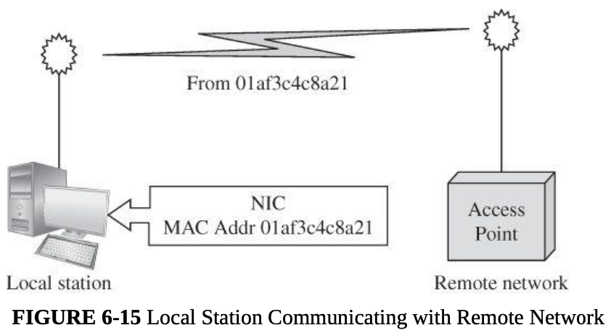
Wireless Communication

Slide 39
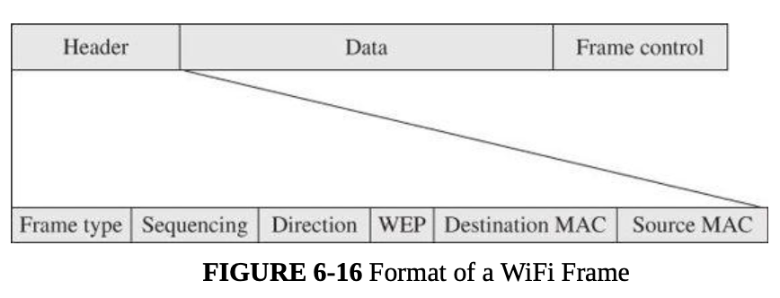
WiFi Frame
Each WiFi data unit is called a frame. Each frame contains three fields: MAC header, payload, and FCS (frame check sequence).

Slide 40
Management Frames
Beacon.
A beacon signal advertises a network accepting connections.
Authentication.
A NIC requests a connection by sending an authentication frame.
Association request and response.
The NIC and access point exchange information about their capabilities and agree on parameters of their interaction and encryption.

Slide 41
Vulnerabilities in wireless networks
Confidentiality
Integrity
Availability

Slide 42
Failed Countermeasure: WEP
Wired equivalent privacy, or WEP, was designed at the same time as the original 802.11 WiFi standards as the mechanism for securing those communications
Weaknesses in WEP were first identified in 2001, four years after release
More weaknesses were discovered over the course of years, until any WEP-encrypted communication could be cracked in a matter of minutes

Slide 43
How WEP Works
Client and access point (AP) have a pre-shared key
AP sends a random number to the client, which the client then encrypts using the key and returns to the AP
The AP decrypts the number using the key and checks that it’s the same number to authenticate the client
Once the client is authenticated, the AP and client communicate using messages encrypted with the key

Slide 44
WEP Weaknesses
Weak encryption key
WEP allows to be either 64- or 128-bit, but 24 of those bits are reserved for initialization vectors (IV), thus reducing effective key size to 40 or 104 bits
Keys were either alphanumeric or hex phrases that users typed in and were therefore vulnerable to dictionary attacks
Static key
Since the key was just a value the user typed in at the client and AP, and since users rarely changed those keys, one key would be used for many months of communications
Weak encryption process
A 40-bit key can be brute forced easily. Flaws that were eventually discovered in the RC4 encryption algorithm WEP uses made the 104-bit keys easy to crack as well

Slide 45
WEP Weaknesses (cont.)
Weak encryption algorithm
IV collisions
Faulty integrity check
No authentication

Slide 46
WEP Weaknesses (cont.)
WEP uses short, infrequently changed encryption keys, it requires no authentication, and its integrity is easily compromised.
Bottom Line: WEP Security Is Unacceptable

Slide 47
WPA (WiFi Protected Access)
WPA was designed in 2003 as a replacement for WEP and was quickly followed in 2004 by WPA2, the algorithm that remains the standard today
Non-static encryption key
Authentication
Strong encryption
Integrity protection
Session initiation
While there are some attacks against WPA, they are either of very limited effectiveness or require weak passwords

Slide 48
Session Summary
Networking basics
Network threats and vulnerabilities
Networks are threatened by attacks aimed at interception, modification, fabrication, and interruption
Wireless network
WiFi security
WPA has many critical security advantages over WEP

